Slide 1
ECO-SEC Home Security System
Group 10
Nathan Schroeder
David Gardner
Brian Kelly
Diana Escobar-Pazo

Slide 2
Motivation
Create a system to protect a user’s home from unwanted intrusions and burglaries
Provide a security system that contains similar functions to professional systems but at a reduced price
Create a security system that does not require additional monthly fees to a security firm
Create a security system that is “green” and is as environmentally friendly as possible

Slide 3
Objectives
Ability to detect if an window or door is opened
Ability to sound alarm if a window is broken
Detect motion of intruders using an infrared sensor
If alarm is triggered system will inform the homeowner via e-mail
Will be constructed at lowest cost possible to be more economically friendly
Will be powered by a series of solar panels backed up by a battery in order to produce a more “green” system
Will use a camera to provide a security feed of the home that the user can view remotely using the website for the system
Users will be able to control the system through a LCD touch screen or a website

Slide 4
Specifications and Requirements
Infrared Sensors will cover a range of 32 ft. with a field of vision covering at least 90 degrees
Sensors will be capable of detecting the breaking of a window from 15 feet away
Door sensor will have a delay of 45 seconds before setting off an alarm when an intrusion is detected
Solar panel will provide 30 Wh of power under 1 kW/hr solar radiation. (Efficiency of above 13%)
Battery will be able to be recharged from discharged to full in 4 hours
Battery will be able to provide power for up to 24 hours if sufficient sunlight for the solar panels is unavailable

Slide 5
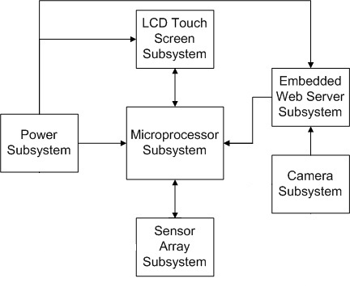
ECO-SEC System Overview
User communicate with the system via either the touch screen or the web server site
Web server and touch screen pass information to the microprocessor when user makes a change in system operation
Microprocessor will communicate with web server and touch screen in order to update status of the system
Power subsystem powers all the other components of the system
Sensor array informs the microprocessor when intrusion occurs
Security camera sends live feed of home to the website that the user can view remotely

Slide 6
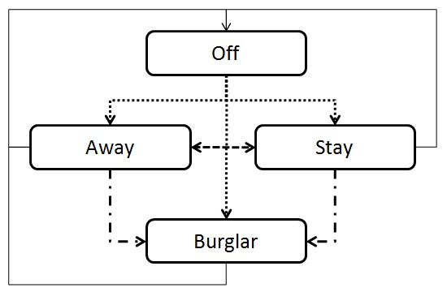
System Modes
Off – system is not powered or is deactivated
Away – system is armed and all sensors are active
Stay – system is armed but motion sensor is not active
Alarm/Intrusion – One or more sensors have been tripped signaling an intrusion, system responds with correct alert. Can be entered using “trick code”

Slide 7
Communication to the MCU
XBee
Uses 2 pins to transfer data through UART
Connection through a MSP430 using I2C protocol
Web Server
Uses 9 pins to transfer data through RS232 (DB9)
LCD Touch Screen
Uses 9 pins to transfer data through RS232 (DB9)
Power
Uses 2 pins to transfer power into the MCU

Slide 8
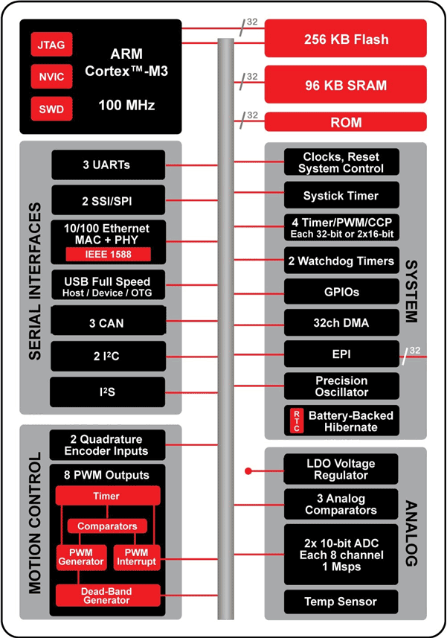
Why TI’s Stellaris M3?
Part Selected
LM3S1538
Ease of use
Programming language (C, C++)
Code Composer Studio
Built-in options
UART
USB
Temperature Sensor
http://www.luminarymicro.com/products/products.html

Slide 9
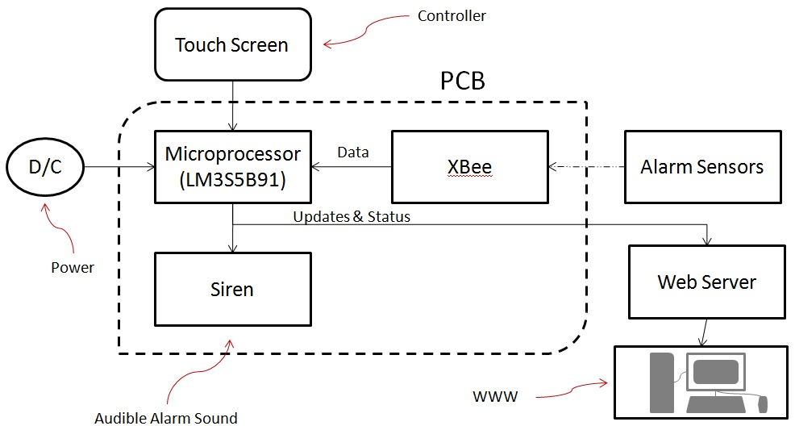
PCB Block Diagram

Slide 10
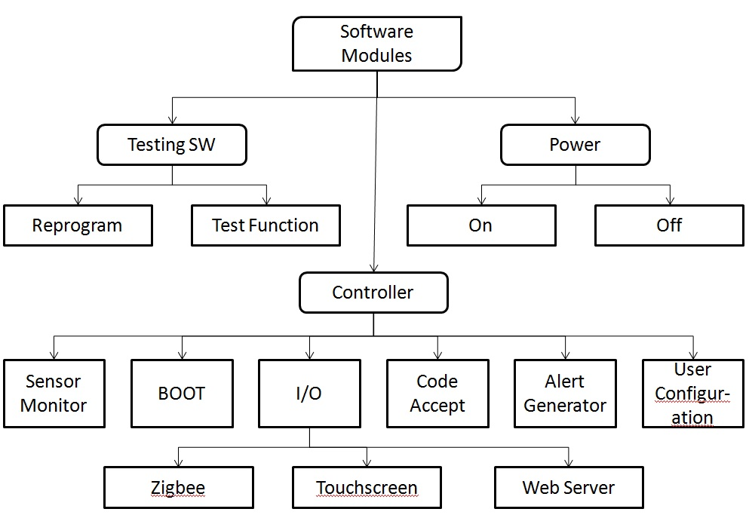
Software Module’s Breakdown

Slide 11
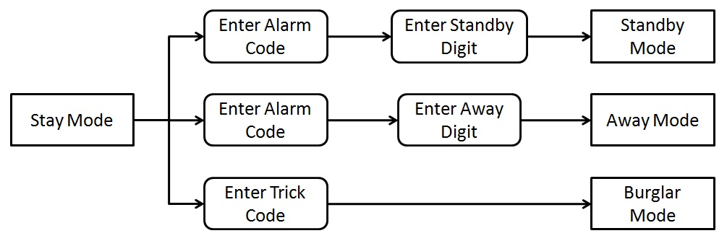
Sample Sequence Diagram for Stay Mode

Slide 12
Testing
Hardware Testing
Alarm system must turn on upon application of power
Components must communicate with the MCU
Siren sounds when Burglar Mode is active
Software Testing
Alarm Modes
Use correct codes to switch between respective modes (i.e. Standby mode to Away or Stay or Burglar or Trick)
Interfaces
Sensors send status to the Alert Generator
Microprocessor generate alerts from the generator
Process alerts through the Code Accept line
Let the user configure alarm features like passwords
Interface MCU with the system’s touch screen

Slide 13
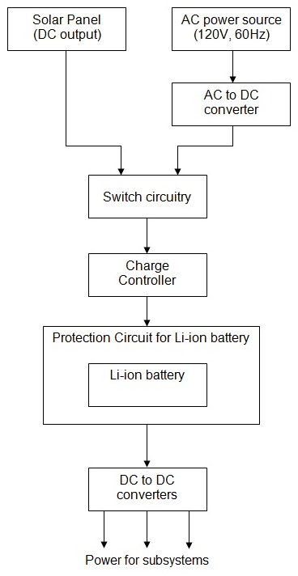
Power Subsystem Overview
Use a wall AC/DC converter for the AC power source.
The switch will select one power source to use.
The charge controller will efficiently charge the battery.
The DC/DC converters will provide the correct voltage for all subsystems.

Slide 14
Product Selection: Battery
Lithium Ion batteries are a good choice.
High power density and low self discharge
No memory effect
Need a protection circuit
Eco-Sec Average Power = 1.42Wh
Distributor | Voltage | Power | Cost
Batteryspace.com | 11.1 V | 31.08 Wh | $64.99
Onlybatteries.com | 11.1 V | 48.84 Wh | $69.95
Onlybatteries.com | 11.1 V | 73.26 Wh | $99.95
Batteryspace.com | 11.1 V | 57.7 Wh | $103.00

Slide 15
Product Selection: Solar Panel
The battery can only accept 2A of charge current.
Maximum power point tracking will not be used.
A 30Wh to 40Wh panel balances cost and power.
Product | Size | Power | Cost
UPG-30 | 23.13” x 11.38” | 30W at 18V | $94.00
UPG-40 | 25.59” x 21.06” | 40W at 17.2V | $128.00
SW-S30P | 21.38” x 20.04” | 30W at 17.4V | $129.00

Slide 16
Switch Circuitry: Logic
Always use solar unless the battery is low and available solar power is low.
It is difficult to check how much solar power is available.
Goals with the switch:
If the battery is low, charge from the AC source.
Allow the microcontroller to force the use of solar power.
The LTC4412 allows logical switching between power sources.

Slide 17
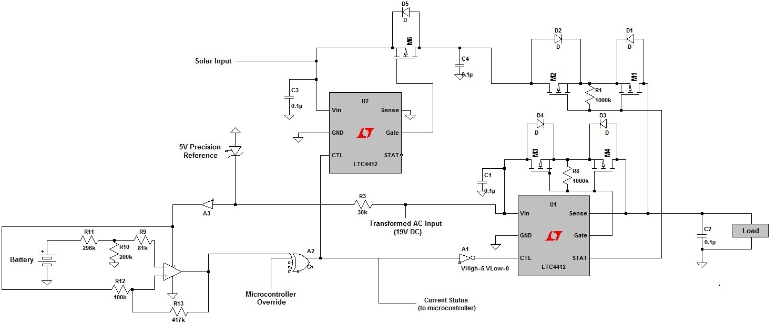
Switch Circuitry: Schematic

Slide 18
Switch Circuitry: Schematic

Slide 19
Switch Circuitry: Schematic

Slide 20
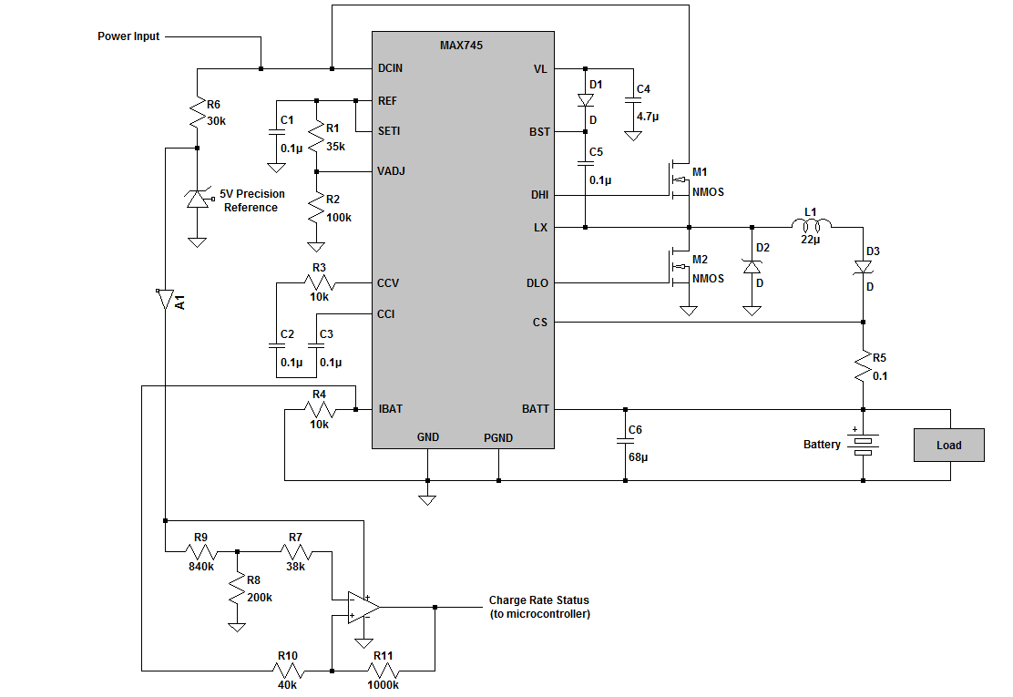
Charge Controller
R1 and R2 set a voltage limit of 12.8V.
IBAT outputs a current proportional to the charging current.
R5 sets the current limit to 1.8A.

Slide 21
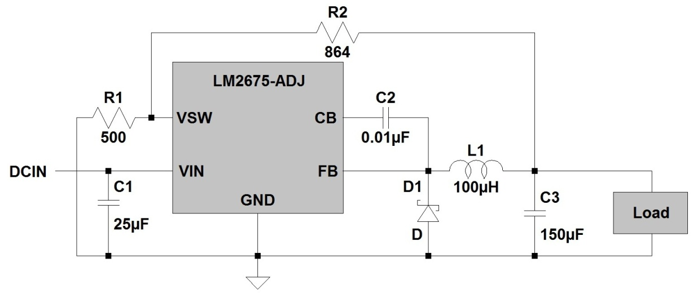
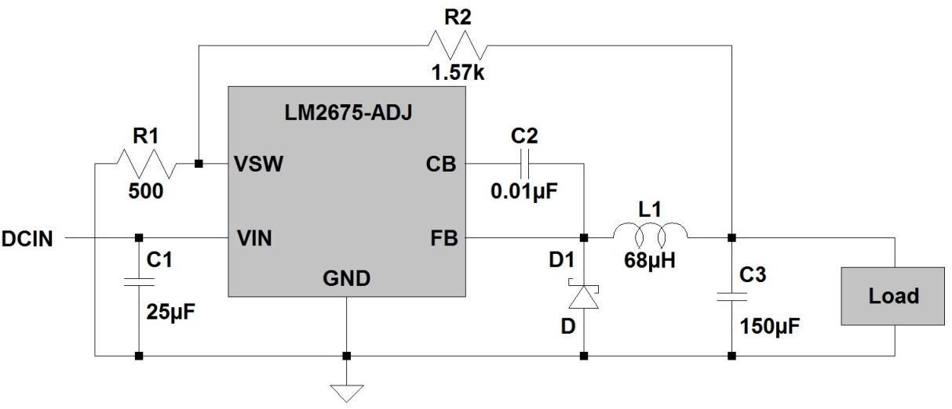
Buck Regulators
3.3V switching regulator for microcontroller.
5V switching regulator for touch screen.

Slide 22
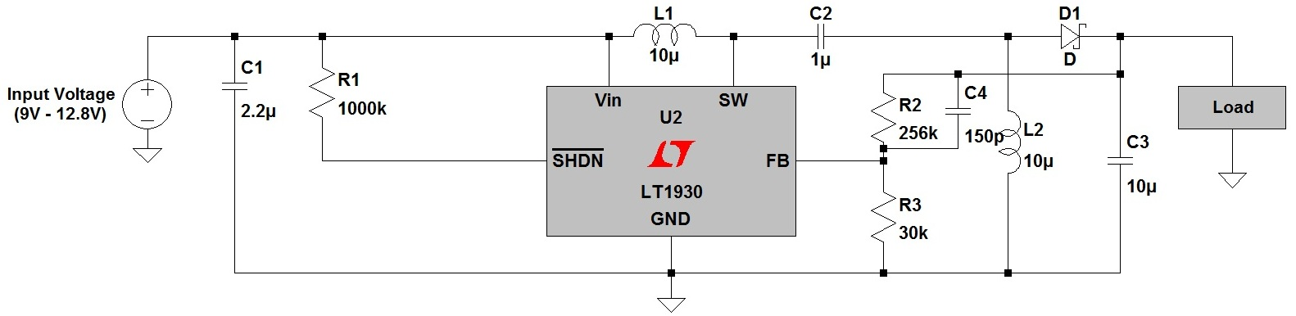
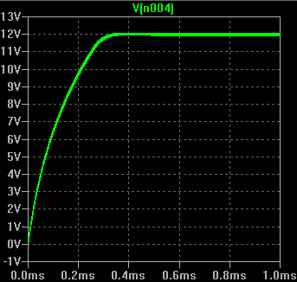
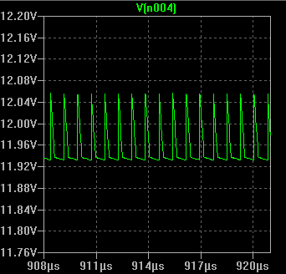
Buck/Boost Regulator

Slide 23
GSM vs. Embedded Web Server
 | GSM Module | Embedded Web Server
Advantages | Access to the system anywhere a GSM signal is available Able to communicate easily with mobile devices via text messages | Provides the functionality of an web site Requires no additional monthly fees beyond standard internet access
Disadvantages | Requires a monthly contract with a GSM provider Provides limited functionality | Requires internet access for web site Can only send emails which limits the devices that are able to receive alerts

Slide 24
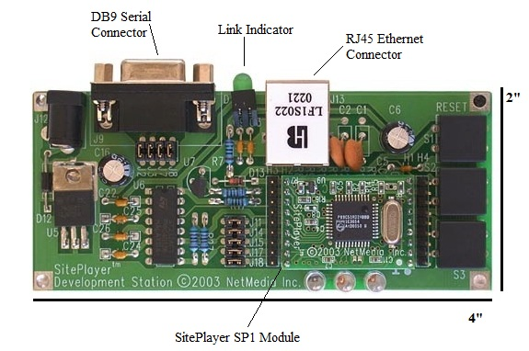
Site Player SP1K
48K of flash storage for web pages
Serial port for processor communication
Can pass data from forms, buttons, or links to the processor
Dynamic or static IP addressing
768 bytes of SiteObjects

Slide 25
Programming the Web Server
Web site created using standard HTML code
Can store data as bits,bytes,integers,longs, or strings using SiteObjects
The value of a SiteObject can be used as part of a reference to a link or image – no need to use any active scripts
Special commands exist to send data from web site to attached microprocessor
Attached microprocessor can also send commands to the web server
Command will be issued to server informing it to send out an email alert when an intrusion is detected

Slide 26
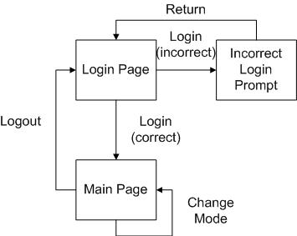
Web Site Flow
Two main pages
Login pages requires password to access main page
Main page displays system status, security video feed, and allows user to change system mode
Simplistic design yet simple to use.
Complexity limited by amount of memory

Slide 27
Choosing a LCD Touch Screen
Display Module | Screen Size | Resolution | Controller Board | Price
LG Phillips | 4.3” | 480x272 | SLCD43 | $349.00
Prime View | 5.7” | 320x240 | SLCD6 | $429.00
Evervision | 7.0” | 800x480 | SLCD5+ | $499.00
NEC | 8.4” | 640x480 | SLCD5+ | $819.00
SLCD6 and SLCD5+ are more powerful controller boards that better support animations on the touch screen
SLCD43 only supports very basic animations but is much cheaper
Resolution quality balanced versus the price of the display important in making a decision
Smaller the screen size also requires less power reducing the requirements of power that must be provided by the solar panels
Size must be large enough to fit the needs of the project

Slide 28
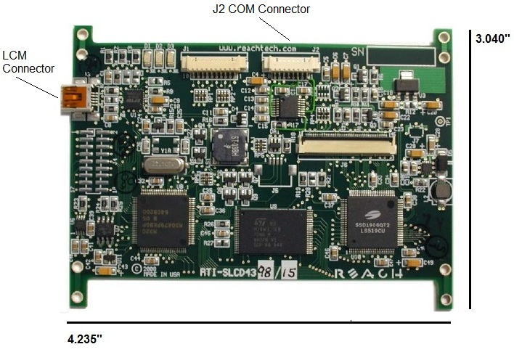
The SLCD43
Most important part of a touch screen display set up
Two main purposes:
Determines what is displayed on the screen
Determines how the display should react when the user presses a certain part of the screen
Can communicate to attached microprocessor via a serial port
Stores all images and other files necessary to create the touch screen interface in flash memory

Slide 29
Creating the Touch Screen Interface
Interface is created through a series of macros
When user presses a button it will call a macro that will adjust the screen accordingly
These macros will also be used to pass data to the microprocessor about the user’s choices when necessary
Most important macro is the start up macro
The start up macro is called when ever the system is powered on from being turned off

Slide 30
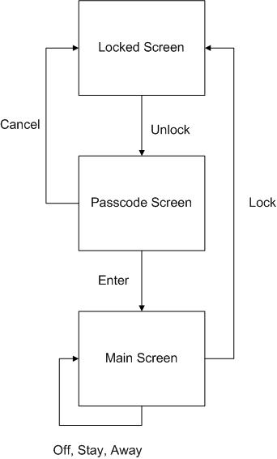
The ECO-SEC Touch Screen Interface

Slide 31
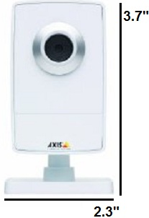
Security Camera Subsystem
Purpose is to provide a live security feed of the user’s home to the web site – requires network camera
Chose AXIS M1011
640 x 480 resolution
Wired model
Fixed position camera
MPEG-4 video format
30 FPS
Progressive Scan RGB sensor
47° horizontal view

Slide 32
Sensors
Motion sensor
Highly integrated, digital and low power sensor from Panasonic.
Glass break sensor
Based on the Texas Instruments sound break detector
Window/door sensor
Proof-of-concept sensor that will use a fiber optic waveguide to carry an infrared pulse instead of conventional magnets

Slide 33
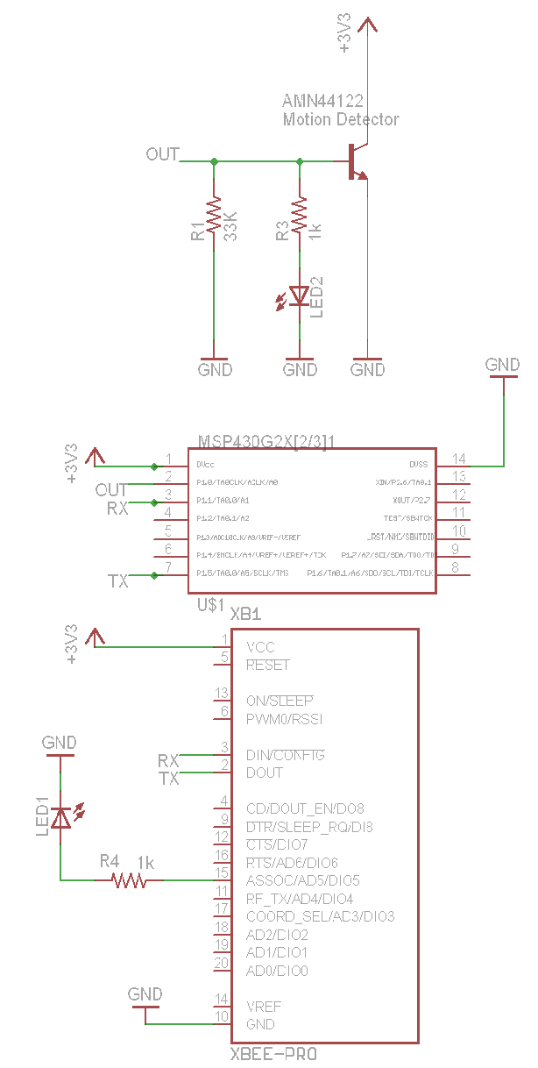
Motion Sensor
Coverage area is of 110° in the x axis with a range of approximately 10m or 32ft.
Low power consumption The detector consumes 165 mAh.
Overall system should last about 2 years.
Recommended - 2 AA lithium @ 3000mAh.

Slide 34

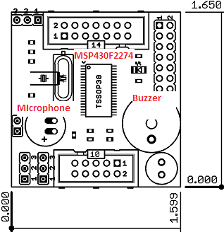
Detect sound of glass breaking in a normal living room of approximately 300m²
Based on the olimex development modules that was derived from a TI application notes.
Low current consumption, will use two AA batteries as in the original TI design.
Using lithium ion batteries we can achieve approximately 1 year and 88 days of life.

Slide 35
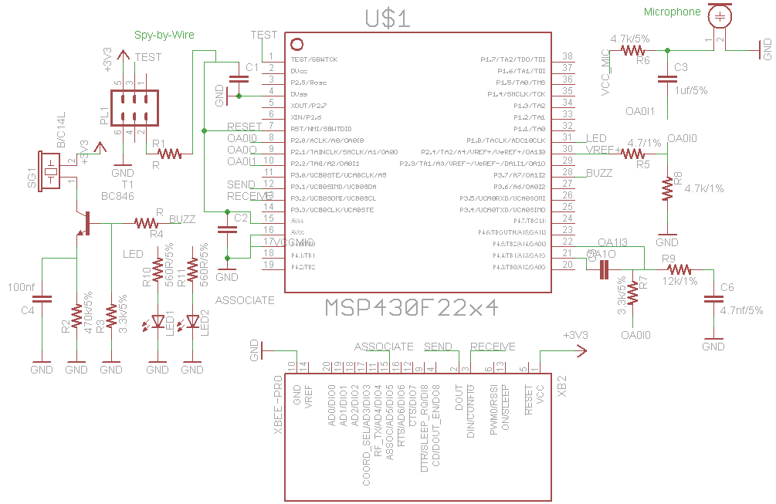
Glass Break Schematic

Slide 36
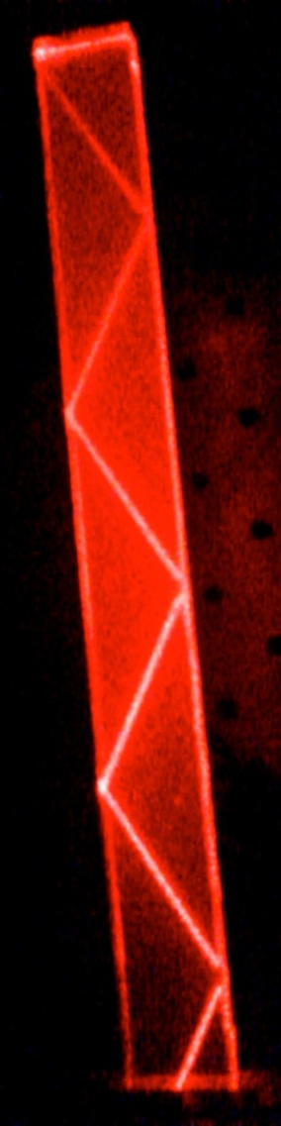
TIR Window/Door Sensor
TIR stands for Total Internal Reflection
Occurs when light travels from a medium of higher to lower reflective index and at an angle higher than the critical angle
Greater distance between detectors >1” vs. ¾”
Lower power consumption at than magnetic sensors at this distances
Will use near IR light at 940nm

Slide 37
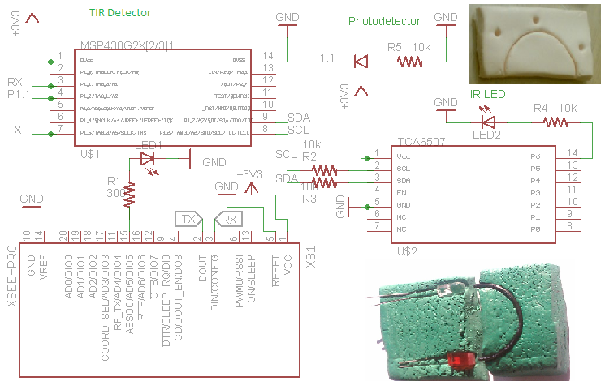
TIR Schematic

Slide 38
Features common to all sensors
All sensors to use an Xbee ZB wireless antenna module.
Report to home base every 3 minutes when system is turned on.
Report voltage and temperature every hour or 20th interval it sends a report to home base.
LCD display for voltage and temperature reporting. Also any errors that can be displayed.
LCD will display if an alarm has been triggered.
LED to report an error with sensor.
Button to initiate self-test.
Connect to a MSP430 Launchpad via Spy-By-Wire for programming.

Slide 39
Project Difficulties
Implement email method for web server
Calibration of the sound sensor
Positioning of the LED sensor and detector for optimum sensing
Finding the smallest radius of curvature that will make the TIR sensor the smallest.
Little experience programming Stellaris M3 microprocessor
Solar panel’s voltage variations might cause problems with the charge controller

Slide 40
Project Successes
LCD Touch Screen prototyped
Embedded Web Server successfully uploaded with web site prototype
Bread-board test of motion sensor successful
Simulations of switch and 12V voltage regulator were successful

Slide 41
Budget and Financing
Part | Cost
4.3” LCD Touch Screen | $349.00
Site Player SP1K Web Server | $79.95
30 W Solar Panel | $100.00
49 Wh Battery with charger | $115.00
Power Subsystem Components | $165.00
AXIS M1011 Security Camera | $169.00
LM3S1538 Microprocessor | $0.00
Wireless Module | $125.85
Glass Break Sensor | $23.45
Door/Window Sensor | $29.44
Motion Sensor | $25.00
Final Estimated Cost: | $1181.69

Slide 42
Current Progress

Slide 43
Immediate Plans to Success
Implement email alert method
Complete sensor prototypes
Finish programming processor
Build power system PCBs
Build microprocessor PCBs
Test final prototype

Slide 44
QUESTIONS?

